Slide 1
CSE115
Programming Language I
Md Mohaiminul Islam
Lecturer, Dept. of ECE
Lecture 05
Version 1: Last updated 04 Oct ‘26

Slide 2
Recap
We talked about data types and arithmetic operators
Arithmetic operations, even though we can intuitively expect what they should do, sometimes behave differently based on the data type of its left operand and right operand
We will see today that there is a precedence/priority between arithmetic operators
We will also talk about scanf in short
Then we move onto comparisons in C.

Slide 3
Learning Address - Revisiting Variables
We know how to declare variables as well as how to initialize them.
But it’s important to know how do they “look” inside the computer memory / RAM
Every possible memory location inside the RAM has an address.
Usually that address looks like a hexadecimal number
And every variable we have learnt to declare always occupies a space inside the memory at some random memory address.
The memory address can be found using the & operator before any variable. Look at the following code.
%p is the format specifier for memory address.
#include <stdio.h>
int main(){
int x = 3;
printf("%p", &x);
}

Slide 4
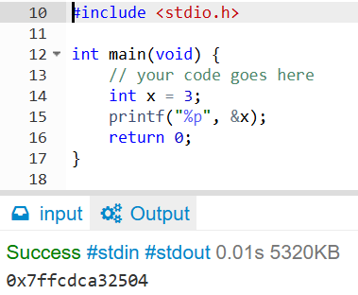
Learning Address - Revisiting Variables
The memory address can be found using the & operator before any variable. Look at the following code.
%p is the format specifier for memory address.
Running the code gives us an output like this.
Every time you run the same code, you'll most probably see a different output. This is because this memory address is allocated at random every time you run your code.
Also, notice that this & operator has nothing to do with the && logical operator we learnt before.

Slide 5
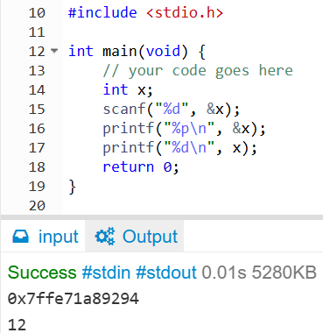
printf and scanf
The function scanf always wants an address where to put our inputted variables.
The function printf always prints what we ask it to print exactly in the format we ask.
The following code first declares an integer x, and allocates 32 bits somewhere in the memory
Then we input an integer using scanf in the address of variable x (here 12 was inputted)
Then, we print that address (not the variable itself) using %p as specifier and &x to get the address
Lastly, we print the integer as usual using %d specifier and variable x.
0x7ff..9294
x :
12

Slide 6
Truthness and Comparison
Relational operators, also known as comparison operators, result in a truthness
There are 6 relational operators
  > ----- greater than
  >= ----- greater than or equal
  < ----- lesser than / less than
  <= ----- less than or equal
  == equal to
  != not equals to

Slide 7
Facing the truth
Let's try to see how truth looks like
int x = 5 > 3;
According to the previous slide, 5 > 3 has a truthness, and the value of the truthness is that it's true.
What if we print it? printf("%d", x);
We will see that true is 1 and false is 0 in C language.

Slide 8
What if...?
Now that we learned about truthness, it's time to use them.
So far we have found some truthness by comparing some stuff, but wouldn't it be better if we could do something based on it?
This is wher the keyword if comes into play.
If you put a truthness value inside the parentheses followed by if i.e. if(some_truthness), then the next statement will only execute if that truthness value is true, not false.
It's important to understand that if can usually control only 1 statement, the one immediately after it.

Slide 9
or else?
In human terms, we often assume the alternative when talking about if.
For example, consider statement A: if it rains, I will be sad.
Now, if it doesn't rain i.e. whatever the condition I have described in statement A becomes false, what will my feelings be?
In human terms, I will be happy. But when talking to a computer, you have to explicitly announce/declare that.
This is where the term else comes in.
else cannot act alone, it always comes after if.
if(raining) printf("Sad");
else printf("Happy");

Slide 10
Combining relop and if
Now that we have used truthness independently and also learnt how relational operators help us forming truths, we can write more meaningful programs.
Let's simply make a grade system that determines whether a student has passed.
if(score >= 60) printf("Pass");
else printf("Try Again");

